Slide 1
Course : Computational Biology
Effective Period : June 2022
Introduction to Biopython Session 1.a

Slide 2
Objective and Outline
LO : Execute a planned simulation of Introduction to BioPython, DNA Sequence Analysis, and DNA Sequence Alignment
In this course we will be simulating basic Bioinformatics analysis using Biopython. Although the Python part is dominant, this course is still ideal for students only with a basic knowledge of biology. The course contains a basic introduction to the Jupyter Notebook and Colab Environment,
In this session, we will start exploring a simulation concept using Open-Source Biopython
Official Website : https://biopython.org/
Outline
Anaconda Installation
Setting up Anaconda environment for BioPython
Setting up Google Colab environment for BioPython
Installing Biopython using Python Notebook (Recommended)

Slide 3
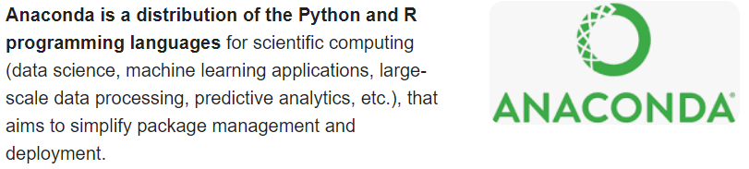
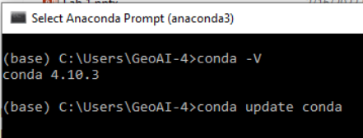
Installation #1 : Anaconda Installation (Local)
Local Installation
(+)
No need internet connection (unless downloading package
Flexible in code structure
No need to connect to cloud storage and install package/ libraries every time
(-)
Complicated
Harder to be shared
Need to manually assess the dependency
Visit and follow the procedure written in these link https://docs.anaconda.com/anaconda/install/windows/ for windows or https://docs.anaconda.com/anaconda/install/mac-os/ for mac users
After the installation, you will find Anaconda Prompt (similar to command prompt or terminal) installed in your machine. Try opening this prompt and to check and update your conda version by typing :
conda –V
conda update conda
y

Slide 4
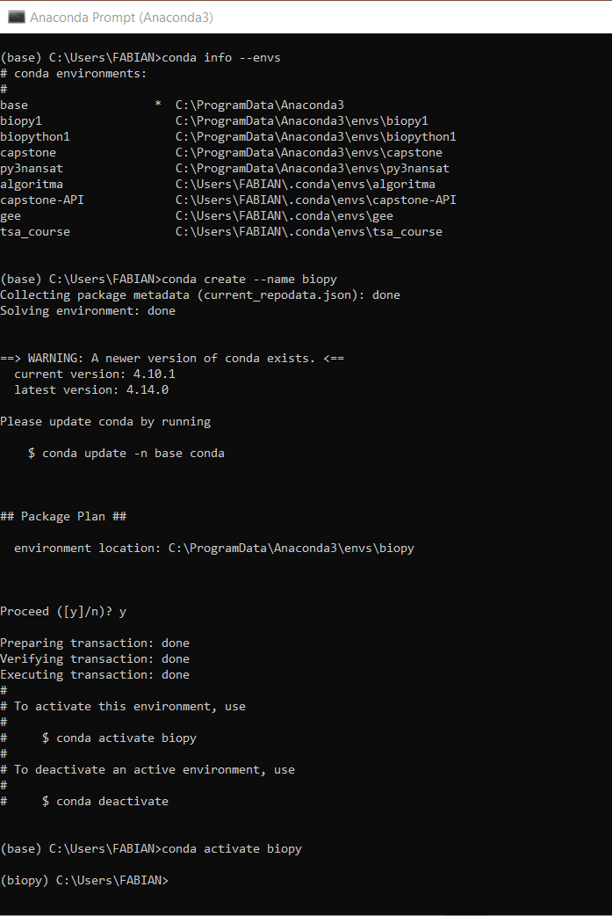
Conda Environment
To create a new env named ‘test’
conda create --name test
To activate a named Conda env
conda activate test
To deactivate current env
conda deactivate
To list all env in your machine
conda info --envs
To list all packages and versions in a named environment
conda list --name test
Create an environment named : biopy

Slide 5
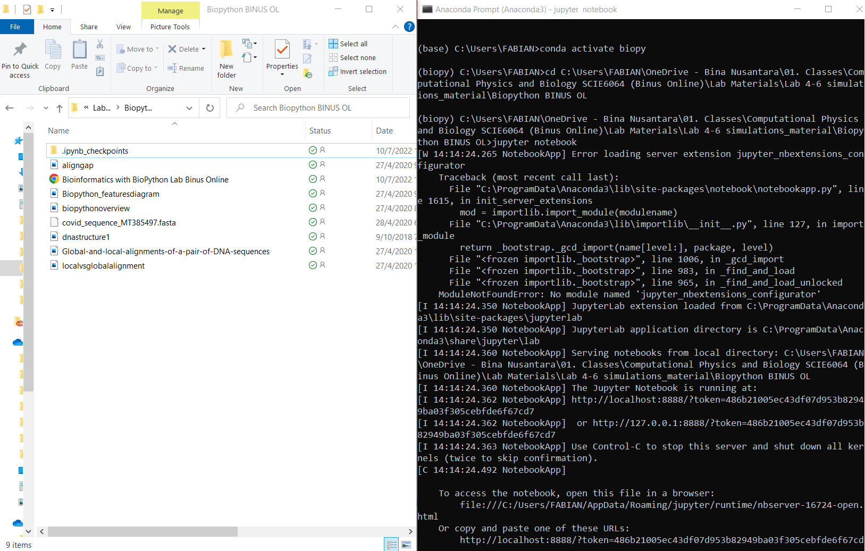
Conda Environment
Download and store your computational biology file from Binus Maya
Store the file in your preference directory where you will have all your simulation date. E.g: D:\......\Computational Biology
Activate the ‘biopy’ environment
Navigating using cd directory command to the file where you put the .IPYNB files
Type jupyter notebook

Slide 6
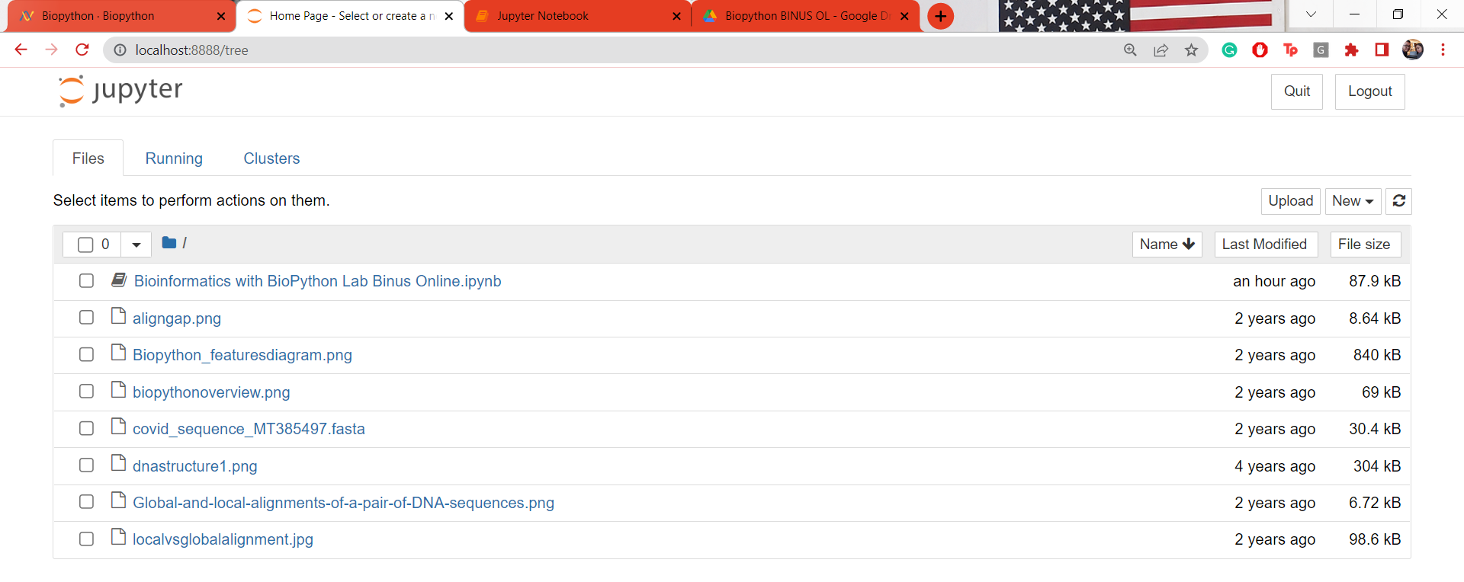
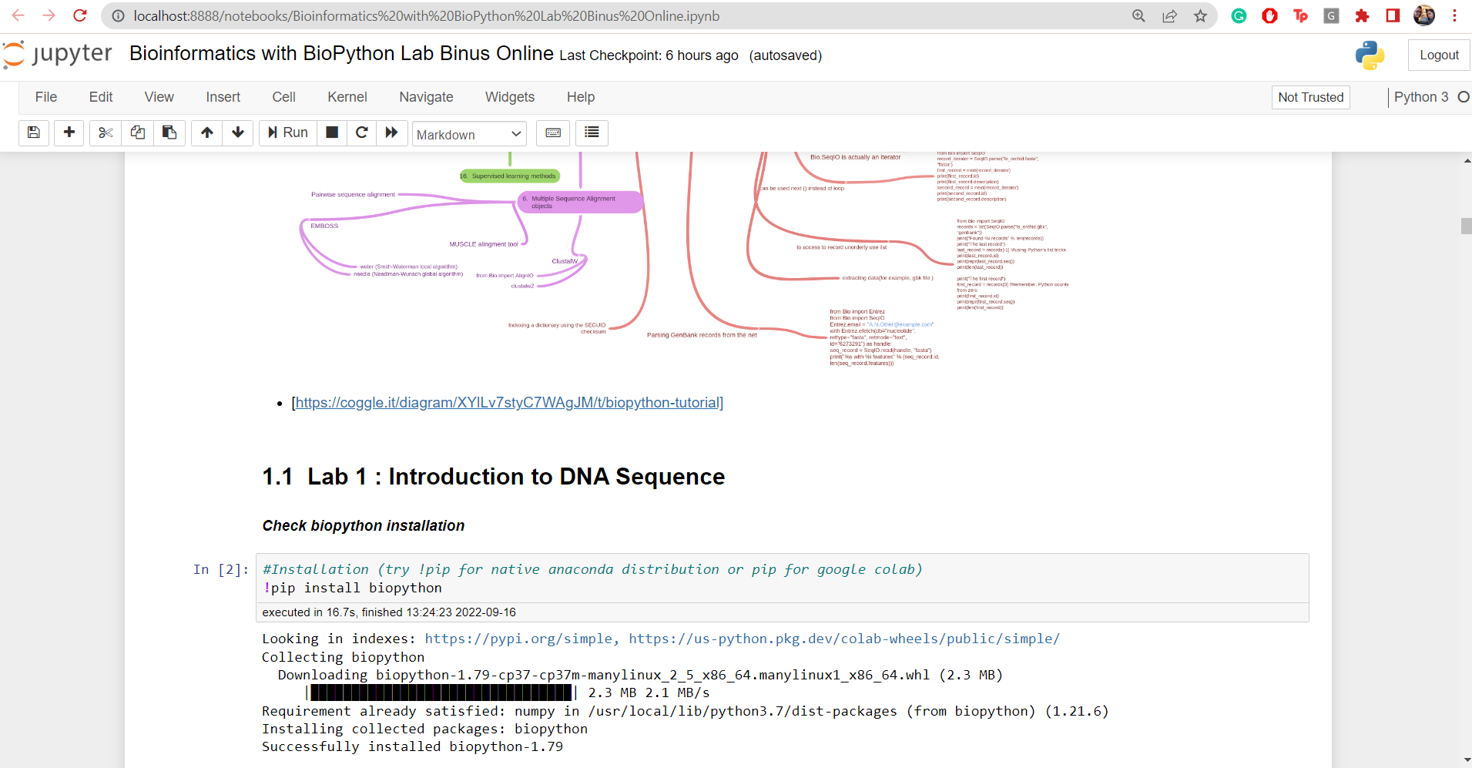
Biopython Installation
Now, you will be redirected to your default browser
Select and Double Click the .IPYNB file and the file will be automatically opened
Go to the Lab 1 : Introduction to DNA Sequence, and run the first code : !pip install biopython
Biopython is installed in your environment, thus when this code run next time, it will only check the version. (Faster)

Slide 7
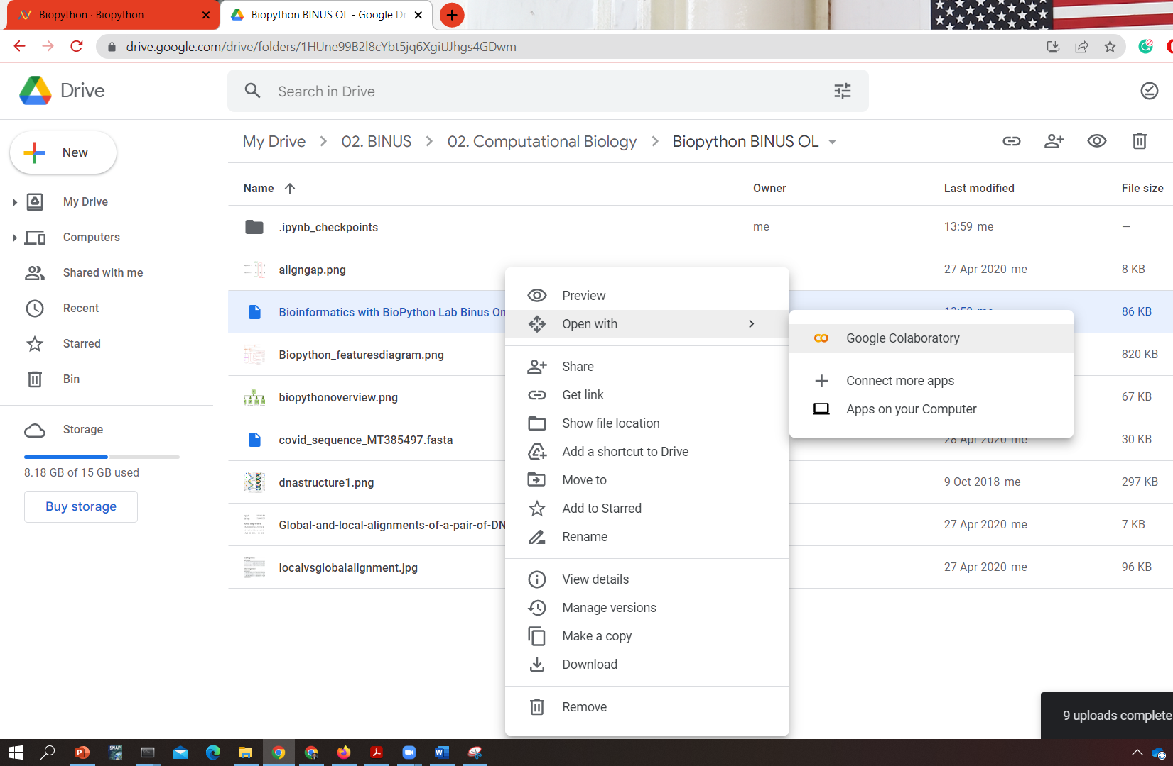
Installation #2 : Google Colaboratory (Recommended)
Using your Google account register a Google Drive cloud storage
Create a file inside, then copy and paste your Biopython Laboratory Files
Right click on the .IPYNB file (Python Notebook File)
Open With → Google Colaboratory

Slide 8
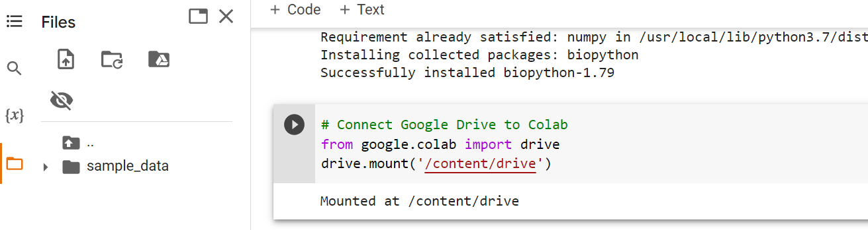
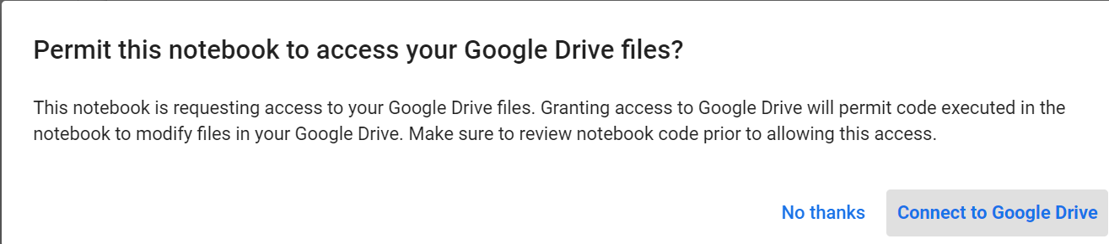
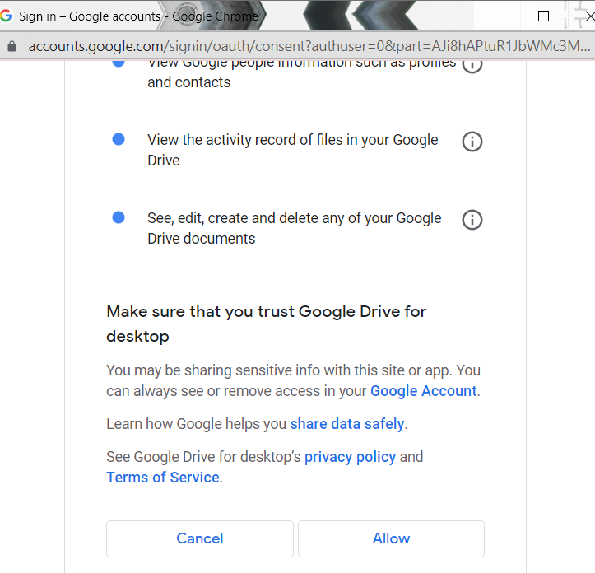
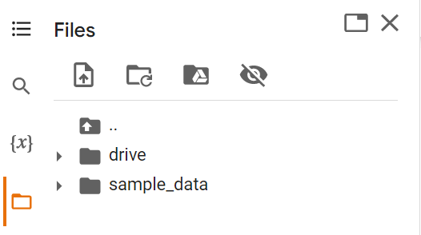
Connect your Cloud Storage to Colab (Optional)
On the left panel, select folders
On the code, search for # Connect Google Drive to Colab
Run the code block
Follow the steps and choose your Google account.
When connected, you will see drive above the sample_data folder

Slide 9
Course : Computational Biology
Effective Period : June 2022
Sequence Analysis Using Biopython Session 1.b

Slide 10
Objective and Outline
LO : Execute a planned simulation of Introduction to BioPython, DNA Sequence Analysis, and DNA Sequence Alignment
In this course we will be simulating basic Bioinformatics analysis using Biopython. Although the Python part is dominant, this course is still ideal for students only with a basic knowledge of biology. The course contains a basic introduction to the Jupyter Notebook and Colab Environment,
In this session, we will start exploring a simulation concept using Open-Source Biopython
Official Website : https://biopython.org/
Outline
Working with Sequence
Sequence and Subsequence Manipulation
Nucleotide Frequency Plot

Slide 11
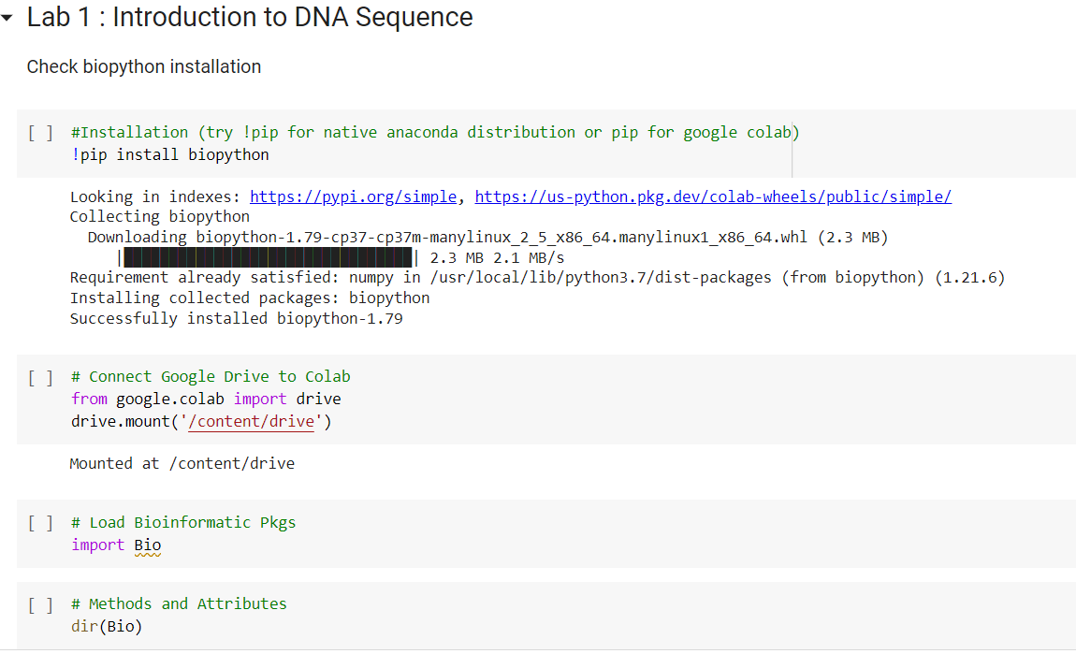
Introduction to DNA Sequence

Slide 12
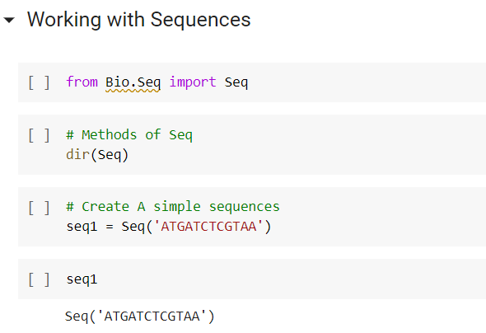
Introduction to DNA Sequence
DNA and RNA Sequence
- A Adenine
- C Cytosine
- G Guanine
- T Thymine
- U Uracil * RNA

Slide 13
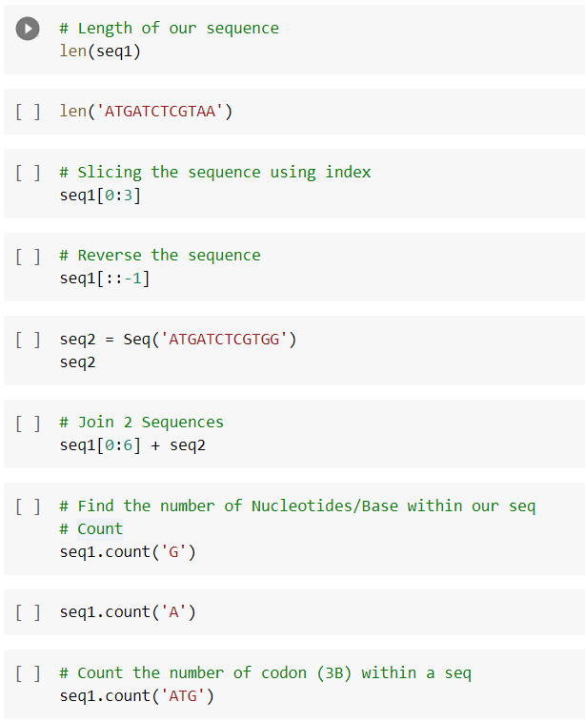
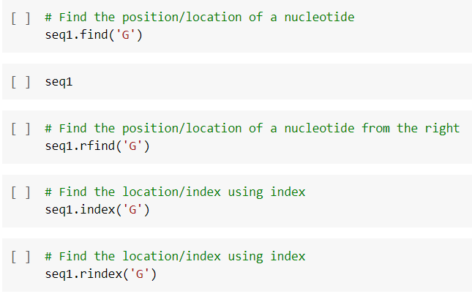
Working with Sequences
Sequence Manipulation
Indexing/Slicing
Join 2 Sequences
Find a Codon in a sequence (Optional)
Count the number of Nucleotides
Find the number of times a patten repeat
Subsequence Search
Plot the Nucleotide/ Base frequency

Slide 14
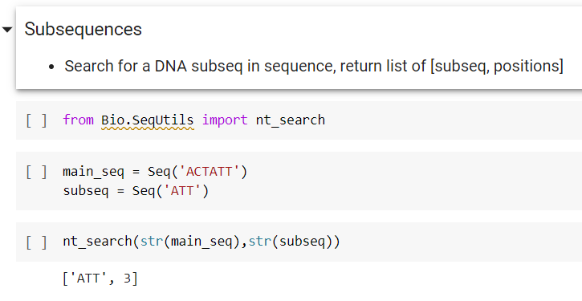
Working with Sequences
Sequence Manipulation
Indexing/Slicing
Join 2 Sequences
Find a Codon in a sequence (Optional)
Count the number of Nucleotides
Find the number of times a patten repeat
Subsequence Search
Plot the Nucleotide/ Base frequency

Slide 15
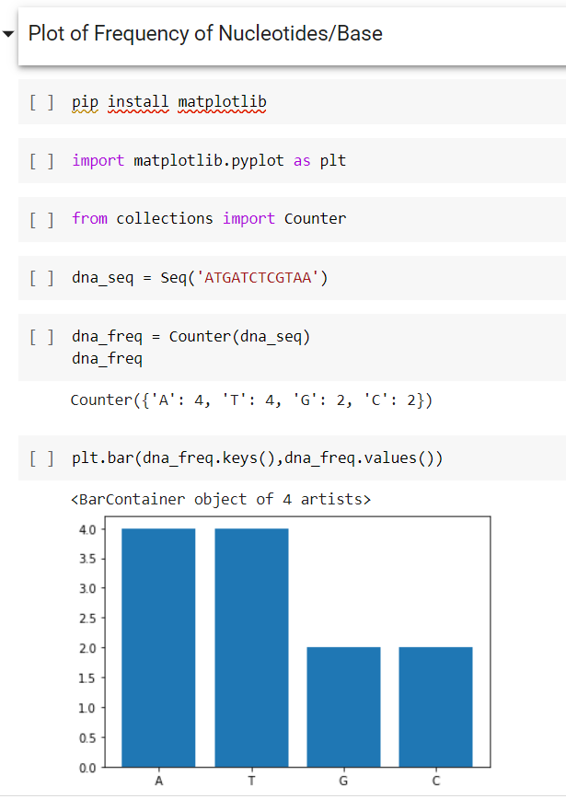
Working with Sequences
Sequence Manipulation
Indexing/Slicing
Join 2 Sequences
Find a Codon in a sequence (Optional)
Count the number of Nucleotides
Find the number of times a patten repeat
Subsequence Search
Plot the Nucleotide/ Base frequency

Slide 16
Exercise
Given 2 sequences :
Seq 1 = 'ATGCATGGTGCGCGA’
Seq 2 = 'ATTTGTGCTCCTGGA’
Plot of Frequency of Nucleotides/Base on each sequence
Next Meeting
Which of the sequence will have the highest GC content?
Which of the sequence will have higher melting temperature
Which of the sequence will have the highest Molecular Weight ?

